Slide 1
Pawfect Match - Phase 3
Group 6 Project 3:
Riya Sachdeva
Rohak Kansal
Rohan Beriwal
Rohan Devgon
Rohan Indora

Slide 2
Stakeholders
Identified
NGOs
Local people
Potential Volunteers
Foster parents
People that report wounded/sick animals
Missing/Found pets
Students (University credits)
Companies that provide funding
RWAs of housing societies
Veterinarians
PETA - People for the Ethical Treatment of Animals
Future scope of collaboration
Pet accessory sellers
Targeted advertising to pet lover community

Slide 3
Interview - NGO Worker
Roles
Challenges
Requirements/
Expectations
Takes care of animals in the shelter
Food/Water
Bath
Play/Exercise
Organises monthly vet visits
Infections/Diseases
Vaccination
Sterilization
Overcrowding of animals
Quick spread of diseases
Shortage of money
Need ambulances to transport sick animals
Shortage of workers
Only 1 known vet; he overcharges for services
Frequent adoption drives
Raise awareness in the community to adopt/foster strays
Connect to funding or donation providers
Connect to other vets in the locality

Slide 4
Interview - RWA President
Roles
Challenges
Requirements/
Expectations
Day-to-day affairs of housing society
Daily complaints of dogs (barking, chasing, biting)
Dogs don’t get food; become aggressive
Dogs recently had 9 kids; population rising
Children are scared; don’t play in the evenings
Conflict b/w dog lovers and people against feeding them
Contact with local vets to sterilize, vaccinate dogs
Get them adopted, relocated if possible
Raise awareness among people so that they contribute money for food and shelter of strays
Someone who can train dogs to be friendly

Slide 5
Interview - Veterinarian
Roles
Challenges
Requirements/
Expectations
Treats sick/wounded animals
Vaccinates and sterilizes animals
Performs dental, ophthalmic and orthopedic surgeries
Unable to reach wounded animals on time
Narrated an incident in which a stray passed away due to absence of timely medical care
People in the community don’t know about available vets
App that alerts him whenever someone reports an animal in need of treatment
Platform through which he can collaborate with charities to help as many animals as possible

Slide 6
Interview - Veterinarian
An Incident
“I once found a labrador pup wrapped in a blanket outside my clinic. His owners had left him there because they couldn’t take care of him anymore. This is not an isolated incident. During the pandemic, many people had extra time at hand and so they bought pets, without realising that a pet is a huge responsibility. After the lockdown ended, they got bored and abandoned them. Fortunately, a friend of mine was willing to take the pup in, but that is not always the case. These animals usually struggle on the streets before succumbing to the weather or their injuries. It’ll be great to see a platform that helps us rehome these animals.”

Slide 7
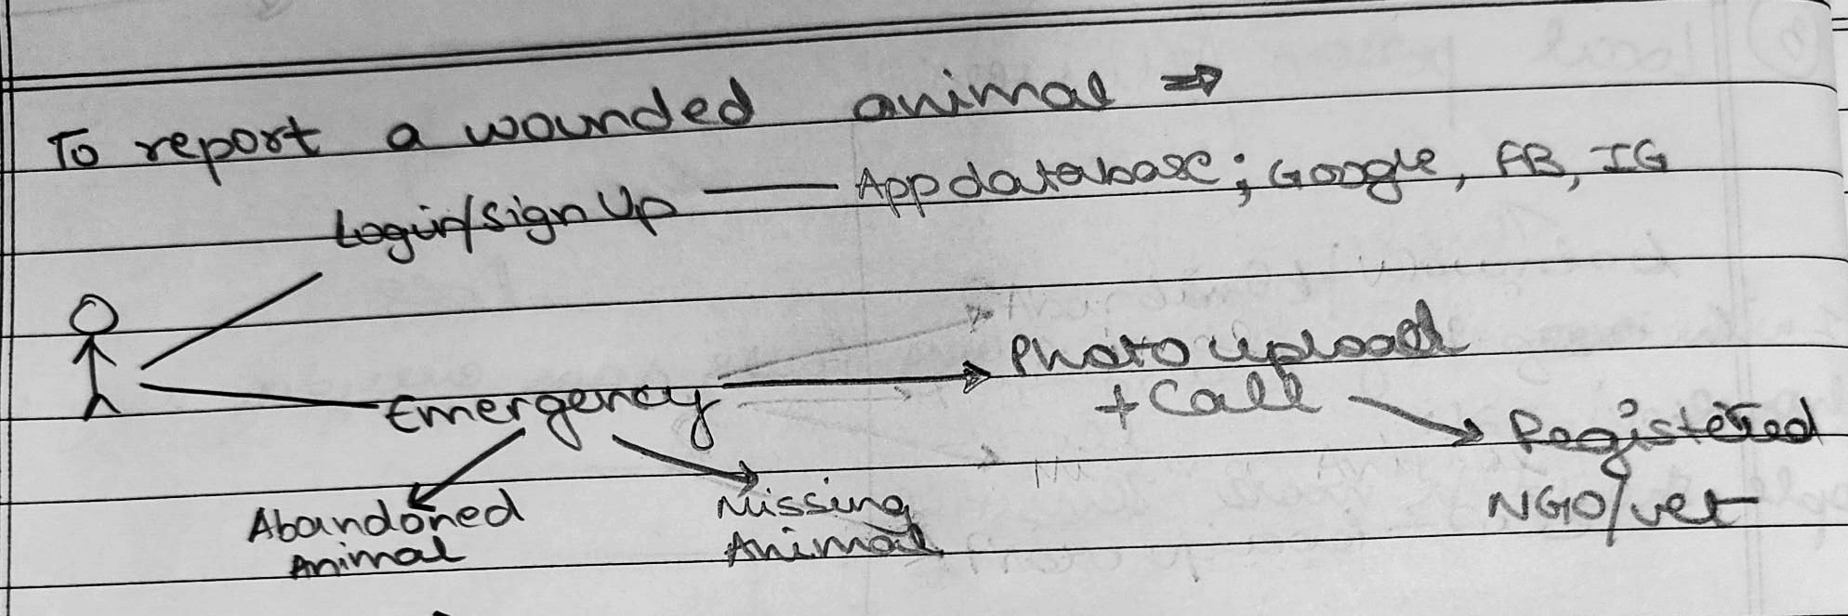
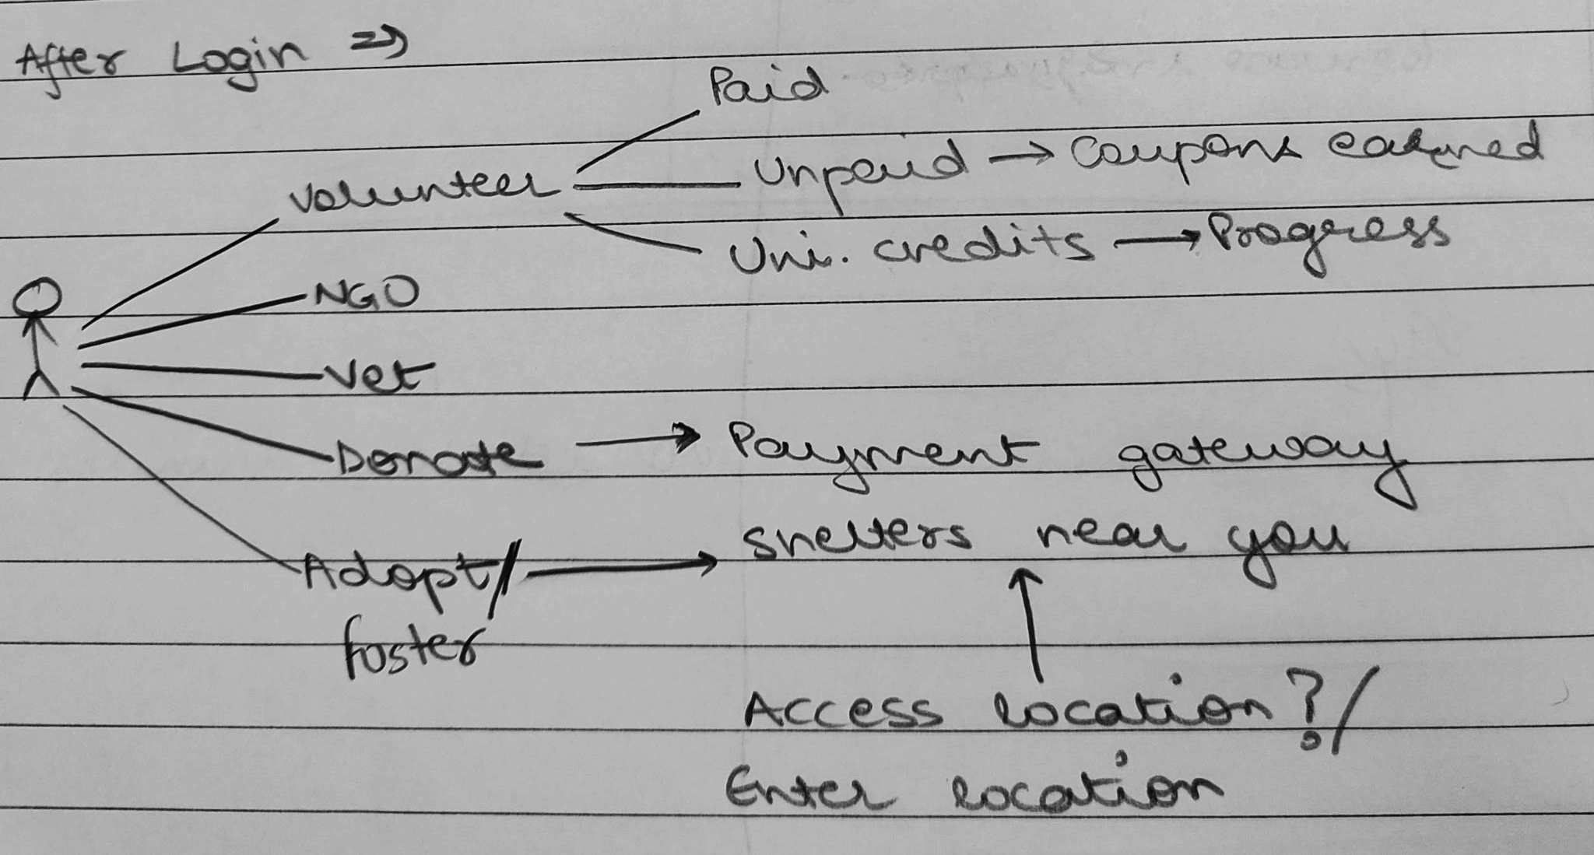
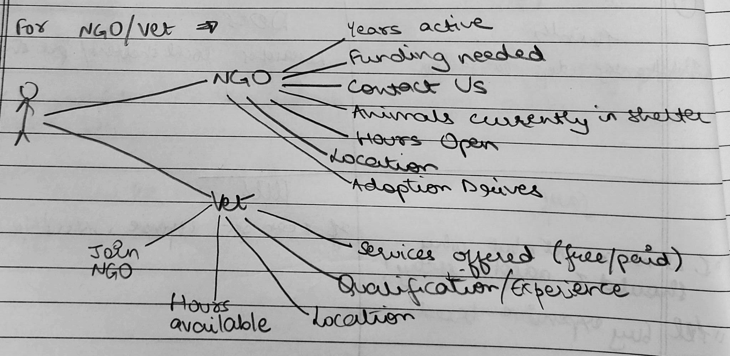
Use Case Diagrams (Initial Sketches)

Slide 8
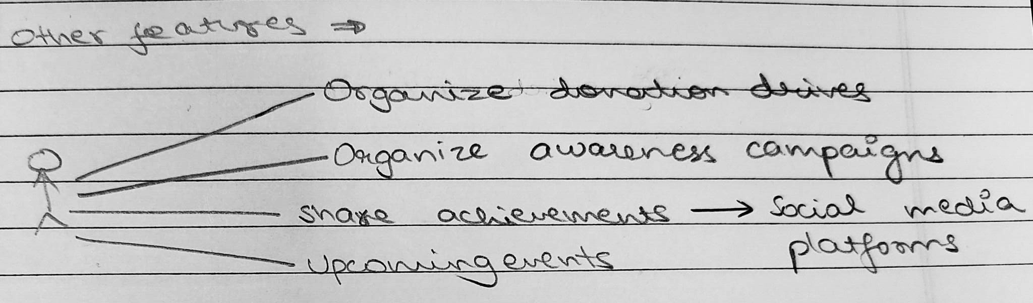
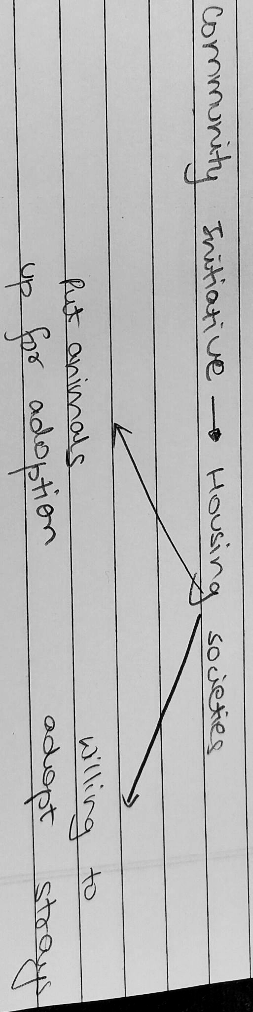
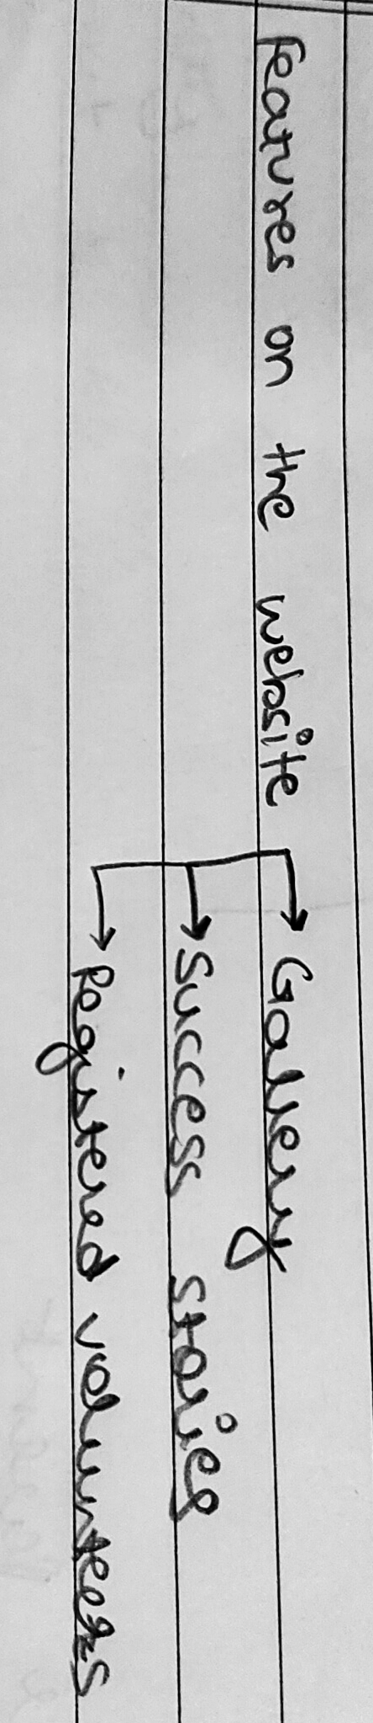
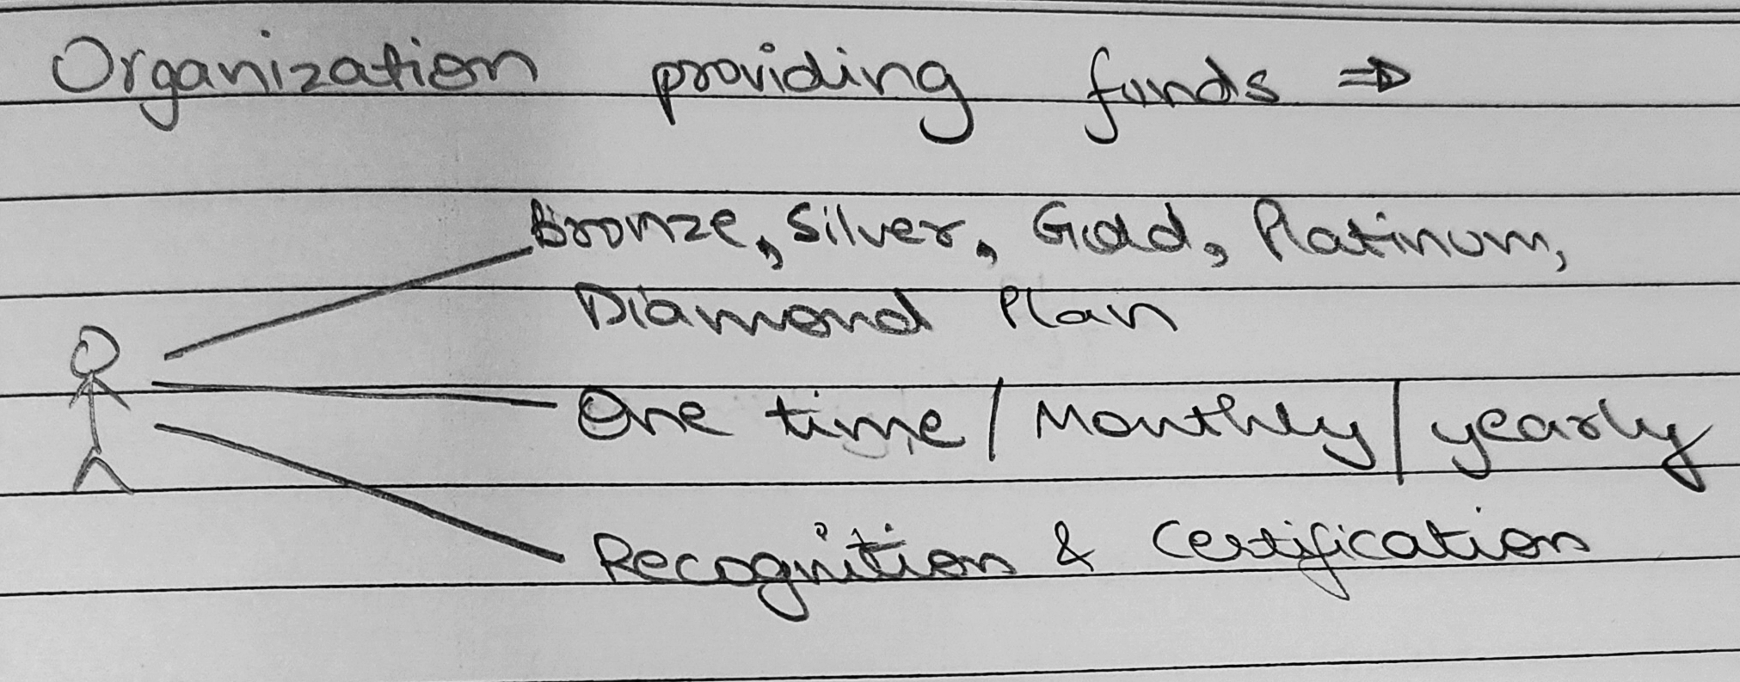

Slide 9
Problem Understanding
Stakeholder
Problem
Solution
Local People/Volunteers
No dedicated platform to report missing animals
It will become easier for people to launch searches for missing animals.
No knowledge about authorities to contact to rescue a stray in need
In case of an emergency/accident, the app will locate the nearest available vet and NGO, and send them notifications. It will also allow the reporter of the incident to call them.

Slide 10
Problem Understanding
Stakeholder
Problem
Solution
Local People/Volunteers
Want to connect with fellow animal lovers in their locality
We aim to establish an active community of animal lovers that regularly share pictures of their pets, tips and tricks on animal parenting, etc.

Slide 11
Problem Understanding
Stakeholder
Problem
Solution
Housing Societies
No knowledge about the proper management of stray animals that reside inside the society premises
A monthly plan of upcoming events (adoption drives, awareness campaigns, vaccination and sterilization drives, donation drives, etc.) will be visible on the app and relevant notifications will be sent.

Slide 12
Problem Understanding
Stakeholder
Problem
Solution
Housing Societies
Wish to rehome stray animals to a place where they can get adequate nutrition and care
RWAs of housing societies will be offered an option to put the local strays up for adoption. Conversely, if the residents cooperate, societies can also volunteer to take responsibility for strays in need of shelter.

Slide 13
Problem Understanding
Stakeholder
Problem
Solution
NGOs
Lack of funds
We will set up a certification standard that companies providing donations can advertise on their websites. This will help in attracting funds towards NGOs in need.
Shortage of volunteers
Discount coupons will motivate people to dedicate a few hours a week towards rescue and care of stray animals.

Slide 14
Problem Understanding
Stakeholder
Problem
Solution
NGOs
Overcrowding of the shelter
Animal shelters will be asked to upload and regularly update the pictures and details (age, health, colour, breed, etc.) of all the animals they house. Whenever a new animal is brought to a shelter, the app will send notifications (with cute pictures of the animal) in hopes of attracting adopters.

Slide 15
Scope, Challenges and Future Plans
The main function of this app is to provide an integrated platform to NGOs, vets, animal lovers, aspiring foster parents and donation providers.
Our aim is to popularise the app in the local community as much as possible, so that the goal of providing prompt help to stray animals in need can be achieved. We will have to develop an active and engaged user base.
We hope to attract significant fractions of companies’ CSR funds.
We hope to sensitize people towards the difficulties faced by stray animals, encourage them to spare money, food, blankets, medication, etc., and foster an environment of harmony and mutual respect.
Once we establish an adequate user base in a test locality, we aim to collaborate with national and international organisations like PETA, Blue Cross of India, Animal Welfare Board of India, IFAW, RSPCA, etc.
We will collaborate with pet accessory sellers, and enable them to do targeted advertisement to the local animal lover community.

